Slide 1
Professional Practices Lecture [3] : Software Engineering and Professional Issues
Dr. Anum Tariq
(Lecturer)
Date: April 23, 2020

Slide 2

Today’s Agenda
Eight infrastructure components that can be used to evaluate a mature profession

Slide 3
SE Education & Training - 1
Ford and Gibbs list four elements related to SE education: initial professional education, skills development, professional development and accreditation [1].
Initial Professional Education:
There are hundreds of computer programs (computer engineering, computer science, and information systems). That include significant material activities devoted to the software engineering education.
There over twenty undergraduate degree programs in software engineering.
The ACM and the IEEE-CS have developed curriculum guidance for software engineering education [2, 3].

Slide 4
SE Education & Training - 1
Skills Development and Professional Development:
Because of the dynamic nature of computing methods and technology, industry and government devote significant resources to the training of software engineers. Web searches for industrial training in software development demonstrates the magnitude of the skills development element.
http://fci.nust.na/?q=courses
The ACM and IEEE-CS promote and support professional development through publications, conferences, workshop and tutorials [4].

Slide 5
SE Education & Training - 2
Accreditation
The Accreditation Board for Engineering and Technology (ABET) has established accreditation criteria for software engineering programs.
The SE program specific criteria reads as follows:
The curriculum must provide both breadth and depth across the range of engineering and computer science topics implied by the title and objectives of the program.

Slide 6
SE Education & Training - 2
Accreditation
The SE program specific criteria reads as follows:
The program must demonstrate that graduates have: the ability to analyze, design, verify, validate, implement, apply, and maintain software systems; the ability to appropriately apply discrete mathematics, probability and statistics, and relevant topics in computer science and supporting disciplines to complex software systems; and the ability to work in one or more significant application domains.

Slide 7
SE Education & Training - 2
Accreditation
The SE program specific criteria reads as follows:
The program shall demonstrate that those faculty teaching core software engineering material have practical software engineering experience.

Slide 8
Ethics and Professional Conduct
Why should we be interested ethics and professional conduct?
Here is one answer:
Today the quality of software produced by software engineers is critical to society.
The success of many, if not most, human accomplishments are dependent on high-quality software (e.g. applications used in financial, legal, library, health, personnel, and transportation systems)

Slide 9
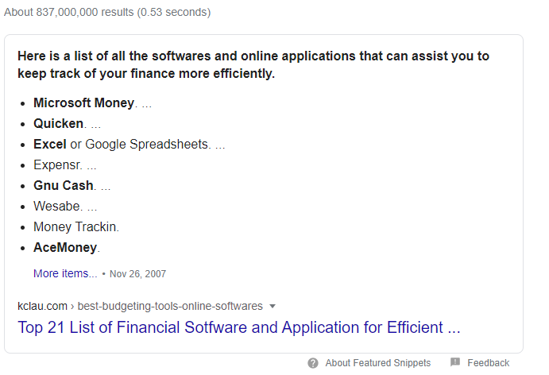
Ethics and Professional Conduct
Top software's used in finance:

Slide 10
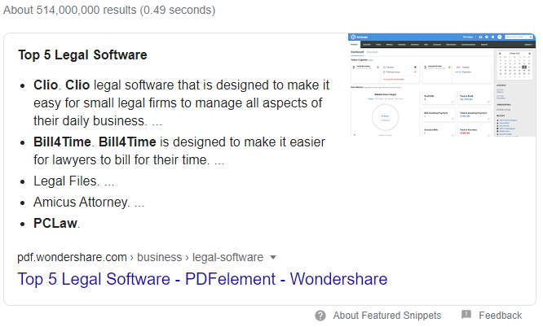
Ethics and Professional Conduct
Top software's used in legal matters:

Slide 11
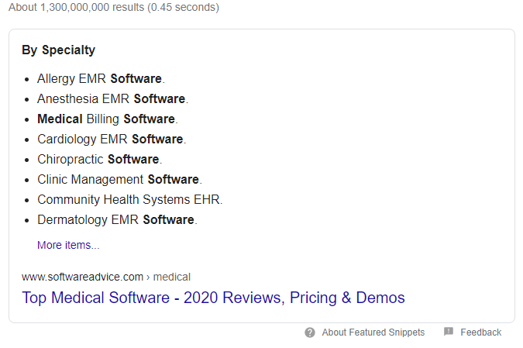
Ethics and Professional Conduct
Top software's used in medical health:

Slide 12
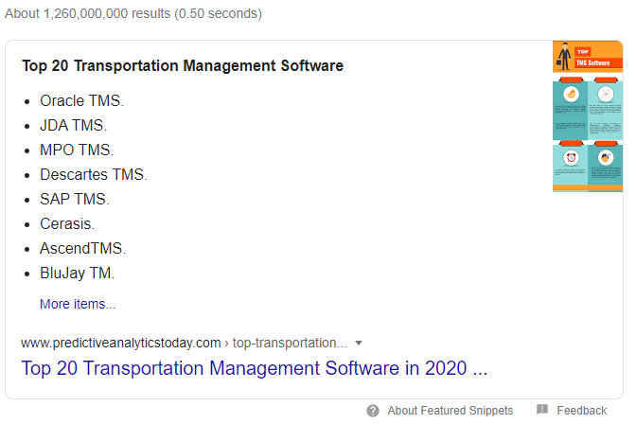
Ethics and Professional Conduct
Top software's used in transportation:

Slide 13
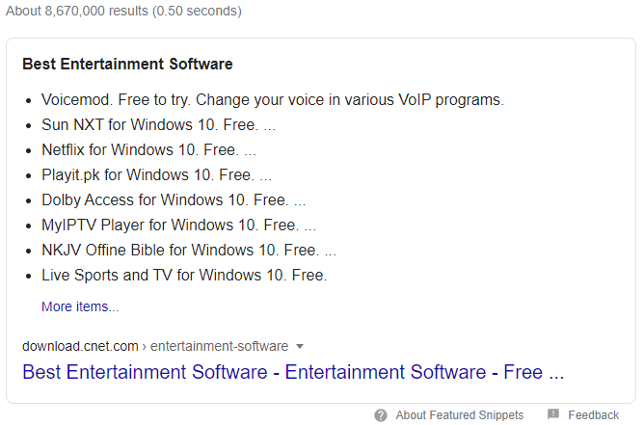
Ethics and Professional Conduct
Top software's used for entertainment:

Slide 14
Ethics and Professional Conduct
Why should we be interested ethics and professional conduct?
Here is one answer:
Today the quality of software produced by software engineers is critical to society.
Lives depend on the safety and reliability of many software systems (e.g. control of aircraft, medical devices, and nuclear power stations)

Slide 15
Ethics and Professional Conduct
Why should we be interested ethics and professional conduct?
Here is one answer:
In addition to technical capability, the quality of software products depend on the ethics and professional conduct of the engineers that developer develop them.
Read some good thoughts about use of GOOD/BAD aspects of technology.
https://www.healthline.com/health/negative-effects-of-technology#positive-effects

Slide 16
Top software failures in recent history:
https://www.computerworld.com/article/3412197/top-software-failures-in-recent-history.html#slide1

Slide 17
Next Class Task
Read the following research paper:
Digital Tools Against COVID-19: Taxonomy, Ethical Challenges, And Navigation Aid
Read the paper carefully and write a summery to answer following questions:
Q1: How their proposed topology helps scientists and policy makers to navigate technological and ethical uncertainty?
Q2: which primary digital public health applications are discussed in this paper?
Q3: which ethical concerns about each application have been discussed in paper?
Q4: what are some limitations authors have concluded related to their proposed solution?
Q5: you will support or negate their idea? Discuss your point of view.

Slide 18
SE Code of Ethics and Professional Practice
Many professions (engineering, law, medicine) provide a code of conduct that defines and motivates professional and ethical behavior by its members.
In 1999, an SE Code was developed by a ACM/IEEE-CS Task Force [4].

Slide 19
SE Code of Ethics and Professional Practice
The code addresses eight areas of concern. The following is short version of the SE Code:
PUBLIC - Software engineers shall act consistently with the public interest.
CLIENT AND EMPLOYER - Software engineers shall act in a manner that is in the best interests of their client and employer consistent with the public interest.
PRODUCT - Software engineers shall ensure that their products and related modifications meet the highest professional standards possible.

Slide 20
SE Code of Ethics and Professional Practice
The code addresses eight areas of concern. The following is short version of the SE Code:
JUDGMENT - Software engineers shall maintain integrity and independence in their professional judgment.
MANAGEMENT - Software engineering managers and leaders shall subscribe to and promote an ethical approach to the management of software development and maintenance.
PROFESSION - Software engineers shall advance the integrity and reputation of the profession consistent with the public interest.
COLLEAGUES - Software engineers shall be fair to and supportive of their colleagues.
SELF - Software engineers shall participate in lifelong learning regarding the practice of their profession and shall promote an ethical approach to the practice of the profession.
In Lecture no. 7, we will discuss these areas in details.

Slide 21
Conclusion
Software engineering is “maturing” profession.
In the coming years the software engineering profession will have to deal with the issues of:
Providing appropriate initial and life-long professional education to its members.
Providing a framework to ensure that its members act in a professional and ethical manner.

Slide 22
References
Ford, Gary and Gibbs, Norman E., A Mature Profession of Software Engineering, CMU/SEI-96-TR-004, Software Engineering Institute, Carnegie Mellon University, Pittsburgh, PA, 1996.(http://www.sei.cmu.edu/pub/documents/96.reports/pdf/tr004.96.pdf)
Association of Computing Machinery – home page (http://www.acm.org/)
Knight, J. , et. al., On Licensing Of Software Engineers Working On Safety-critical Software, Final Report of an ACM Task Force, August, 2001 (http://www.acm.org/serving/se_policy/safety_critical.pdf)
ACM/IEEE-CS Joint Task Force on Software Engineering Ethics and Professional Practices, Software Engineering Code of Ethics and Professional Practice , Version 5.2, (http://www.acm.org/serving/se/code.htm)

